Slide 1
Zig Zag Boom (clone)

Slide 2
Summary
Zig Zag Boom is an endless runner style game, where the challenge is to navigate an never-ending hallway with your 'dot' character.
The game ends when you run into a wall.
Points are earned for every zig or zag passed in the endless hallway.

Slide 3
Mechanics List (no specific order) 1 of 2
Player
  A dot that 'ejects' particles and leaves a trail as it moves.
  Moves in a line at either +/- 45 degrees to vertical.
  Can collide with sides of hallway.
Inputs
  Inteface uses buttons.
  In-game uses one-touch to change player direction.
Hallway
  Composed of parallel lines.
  Zigs and Zags randomly.
  Varies in width.

Slide 4
Mechanics List (no specific order) 2 of 2
Camera
  Player stays in center of screen.
  World moves around player.
  Backgroud parallax.
Design Settings
  Orientation: Portrait
  Aspect Ratio Targets: iPhone 5/6/6+, iPad
Special Hardware Requirements: None.
Game Logic
  Player gains a point for every 'corner' (zig or zag) passed.
  Individual game session ends when player collides with a wall.

Slide 5
Interfaces Inventory
Launch
Splash
Main Menu
Play GUI
'Ever Play' ???
Leaderboards and Achievements
IAP
Info
Options
Interstitial Ads
Banner Ads

Slide 6
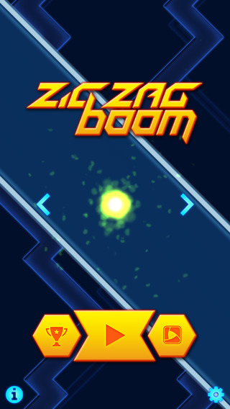


Sample Screens

Slide 7
Get, Play, and Watch The Game
Android:
  https://play.google.com/store/apps/details?id=com.mudloop.zigzagboom&hl=en
iOS:
  https://itunes.apple.com/us/app/zig-zag-boom/id955170175?mt=8
Videos
  https://www.youtube.com/watch?v=hg7m_Ocac2g
  https://www.youtube.com/watch?v=hDlZ-qlvrO4

Slide 8
Object Types
Object Types (Name and Number)
1 – Player
2 – Wall (hallway line)
3 – Trail
4 – Explosion
5 - CornerSensor

Slide 9
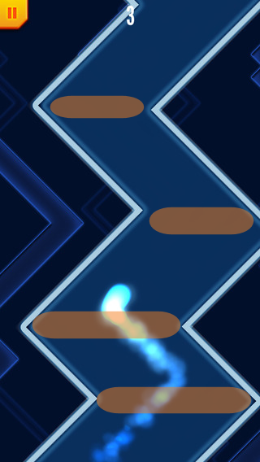
Interactions
Player collides with Wall.
Explosion collides with Wall.
Trail collides with Wall.
Player collides with CornerSensor

